Slide 1
Monday Progress Report: Team 3
By: Anna, Mohamed, Sami & Khoa

Slide 2
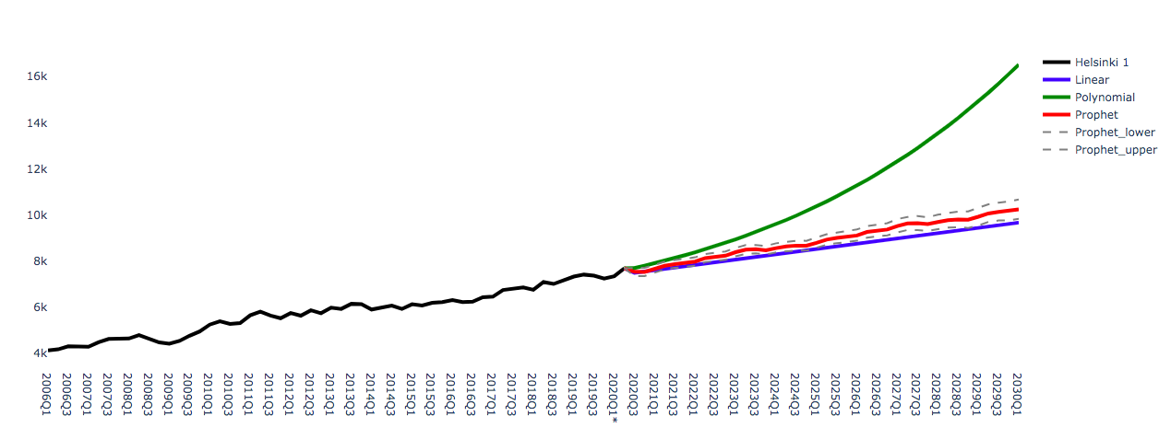
Previously:
Prediction for Helsinki 1:
1:

Slide 3
From what year should we start predicting?
Decided to study the average error in predictions:
Mean Squared Error?
Root Mean Squared Error?
Mean Forecast Error?
Decided to start with Mean Square Error

Slide 4

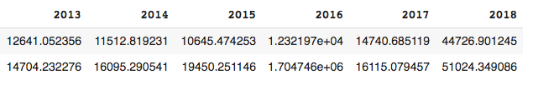
Mean Square Error:
MSE for all regions:

Slide 5
Next Steps
Research and test other measures of accuracy
Implement time series prediction staring from the chosen year
Consider the possibility of deleting the rows that do not have enough data
To have preliminary prediction for 2020 and 2021

